Slide 1

Customer Lead Prediction
Tools Used : Excel, SQL, Power BI

Slide 2
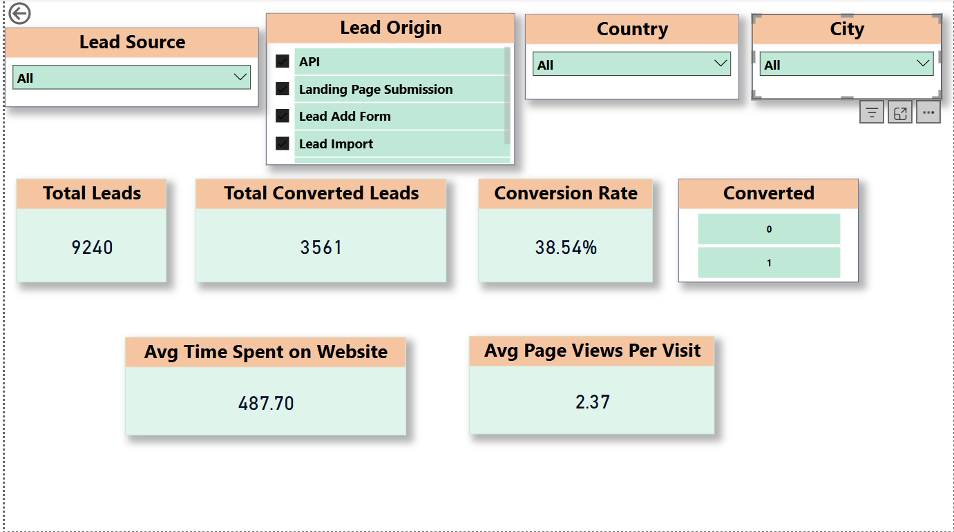
Initially created KPI cards and slicers for metrics to find 1)Lead source 2)Lead origin 3)Country 4)city 5)total leads 6)converted leads 7)conversion rate 8)avg time spent on website 9)avg page views per visit

Slide 3
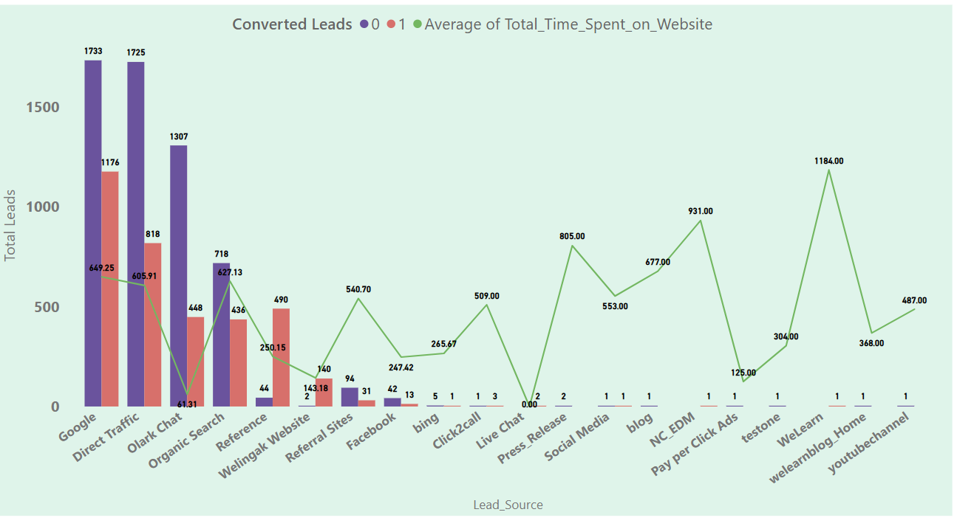
1) From the above graph we get to understand lead source by total leads and avg time spent on website this helps us to analyse that google and direct traffic are top lead sources 2) which lead source have maximum convertion 3) avg time spent on websites as per lead source 4) we also have tool tip to understand conversion ratio

Slide 4
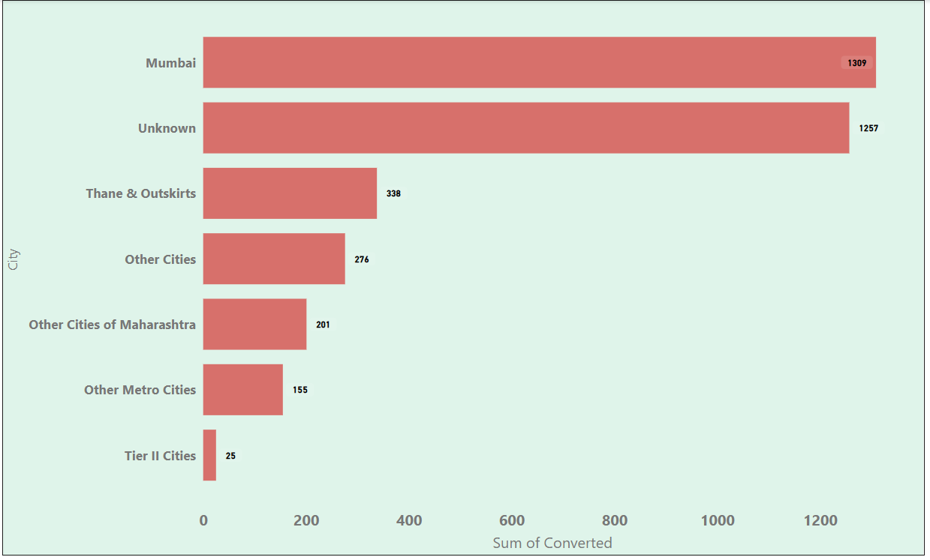
1)From this visual we can see that conversion of leads based on city 2) Top city by lead conversion is Mumbai followed by unknown and thane & outskirts 3) we have 1309 converted leads under Mumbai city 4) Least is tier II cities

Slide 5
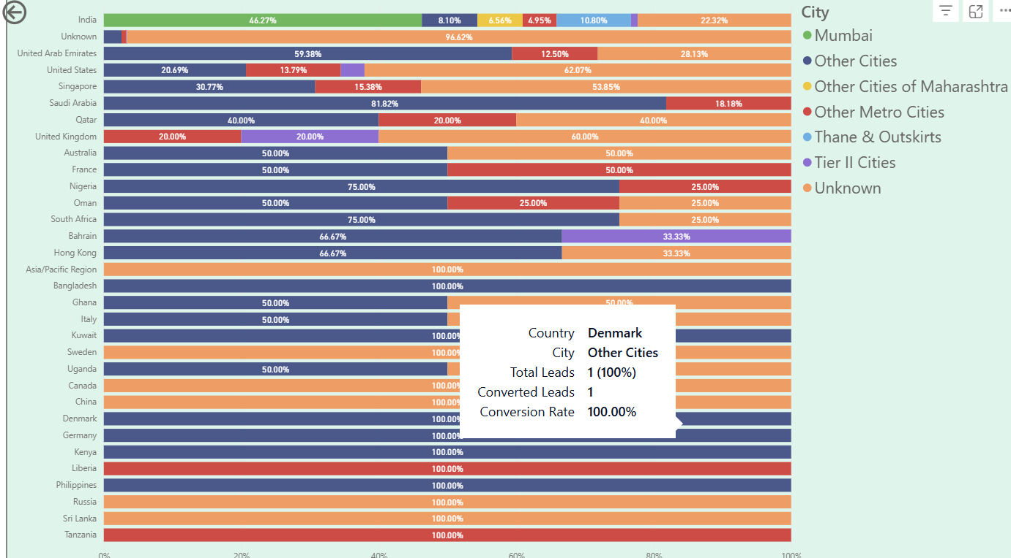
1)From this visual we can analyse that under country we have top leads from india followed by unknown and united arab emirates 2)we have differentiated the bars using city as a legend 3) we also have total leads, converted leads, conversion ratio as tooltips as we hover on the bars 4)we have least leads conversion from Tanzania, sri lanka and Russia countries

Slide 6
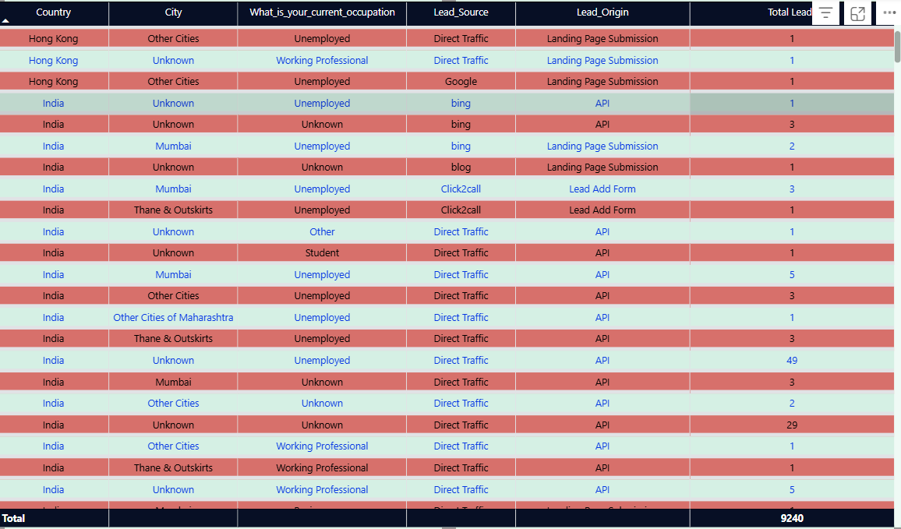
1) This table view helps to understand country and city city count of occupation, lead source , lead origin and total leads 2) this detailed view helps to analyse individual breakdown

Slide 7
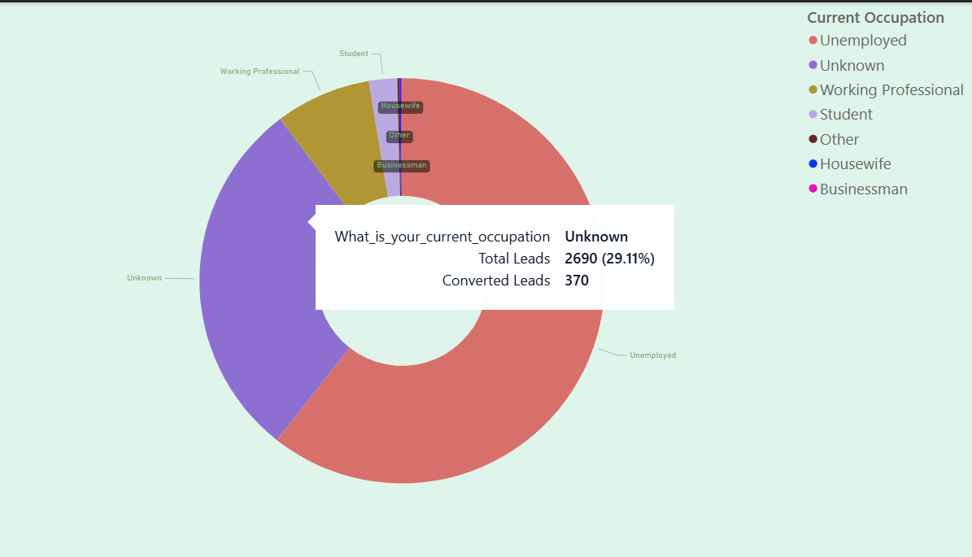
1) This donut visual helps to understand percentage of occupation along total leads and converted leads as tooltips 2)we can see unemployed has major share or percentage then comes unknown 3) least share is for businessman and housewife

Slide 8
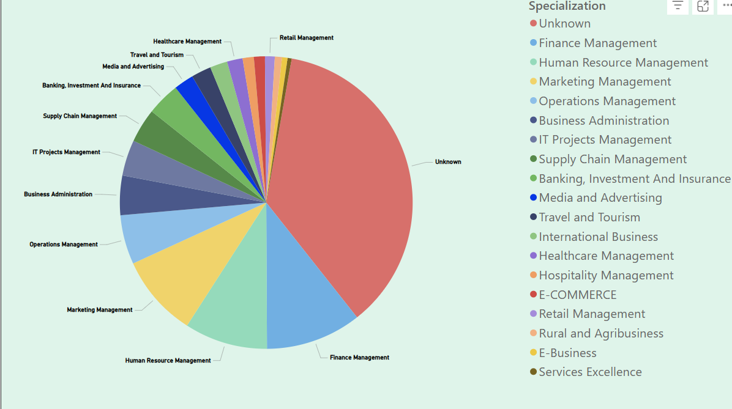
1) This pie chart visual helps to analyse the breakdown of specialization 2) We can see major contribution is unknown then comes finance management followed by human resource management 3) bottom 3 are services excellence, e-business, rural and agribusiness

Slide 9
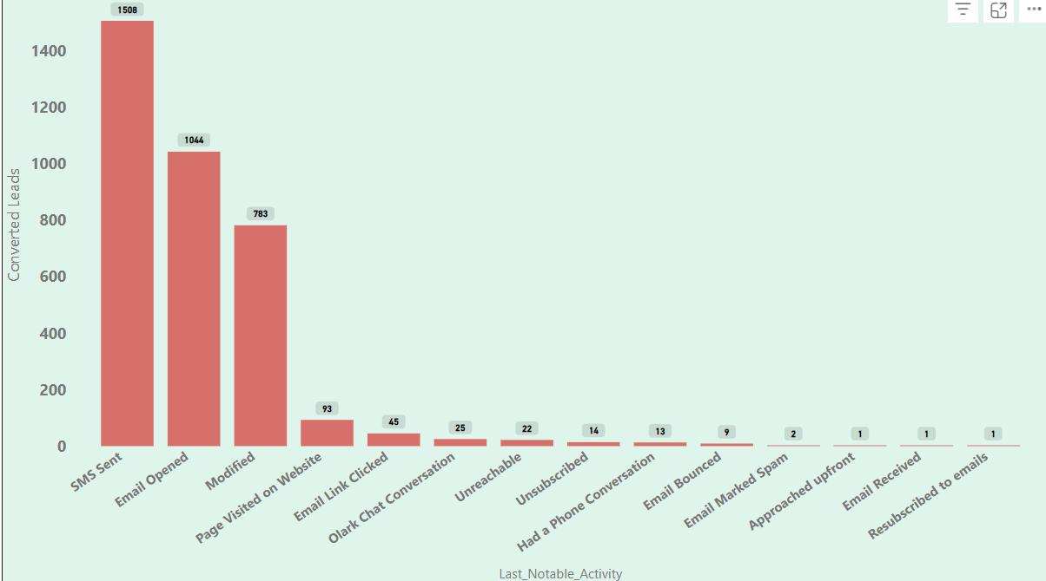
1) This bar graph helps to understand the last notable activity and how it is helping fro lead conversion 2)we have sms sent as top bar visual followed by Email opened with 1044 converted leads and then modified 3) bottom 2 are resubscribed to emails and email received with 1 converted lead each.

Slide 10
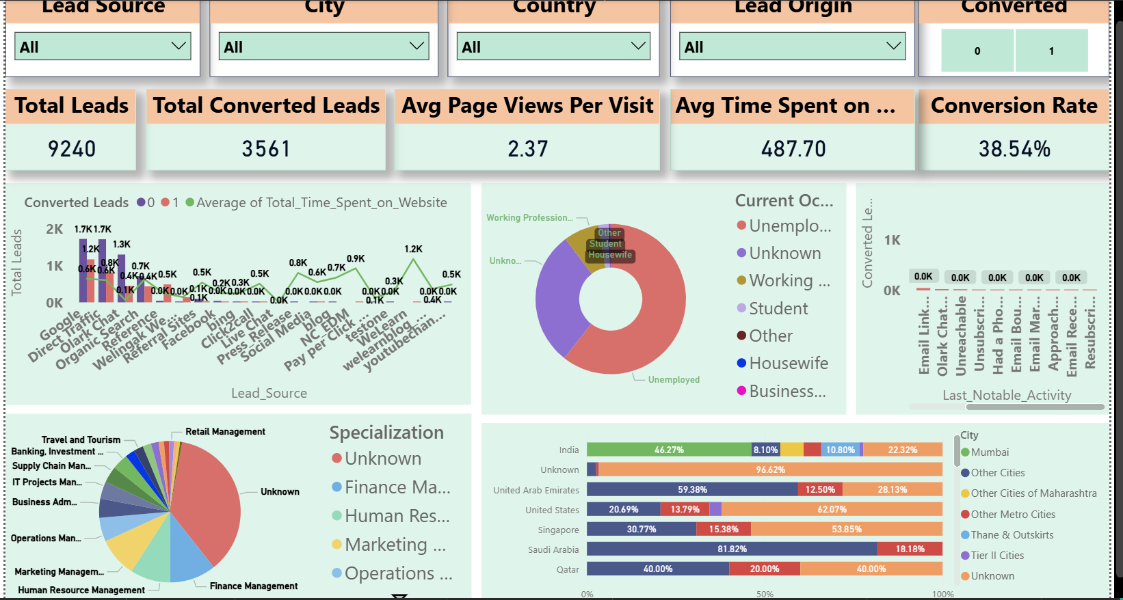
1) This is our final dashboard 2)We can analyse the entire data source like how many leads are converted, country ,city , lead source wise 3)also helps to understand avg page views per visit, avg time spent on website 4)last notable activity details 5)specialization and occupation wise detailed break down 6)trend ANALYSIS GRAPH HELPS TO UNDERSTAND THE LEADS CONVERTED OVER AVG TIME SPENT ON WEBSITE 7) We also have various cards to understand conversion ratio

